Slide 1





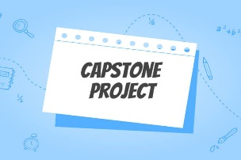

مدرسة موبيكا الدولية للتكنولوجيا التطبيقية
mobica International Applied Technology School
Mobica. Capstone Project
2024

Slide 2

مدرسة موبيكا الدولية للتكنولوجيا التطبيقية
mobica International Applied Technology School
mobica. Capstone Project (2024)
Capstone Project
Team Code: J2-0902307
Students Names | St. Code
1-Roaa Tawfik | 0924109
2-Ammar Mohamed | 0924085
3-Mohamed Ehab | 0924088
4-Mawada Saleh | 0924021
5- Yasmin abbas | 0924125

Slide 3

مدرسة موبيكا الدولية للتكنولوجيا التطبيقية
mobica International Applied Technology School
mobica. Capstone Project (2024)
Presentation Outline
Auto motion

Slide 4



Problam
Fhh
مدرسة موبيكا الدولية للتكنولوجيا التطبيقية
mobica International Applied Technology School
mobica. Capstone Project (2024)
Capstone Project Theme
Problem:
The problem is that there are many stores that take pains to collect the most popular models, and it takes time for them to prefer to look on social media or find new items in the market. They also bring watches and models that are not compatible with fashion, so these clothes are sold at a low price, thus losing about 40% of the product price.
https://www.google.com/url?sa=t&source=web&rct=j&opi=89978449&url=https://www.aspentech.com/en/apm-resources/production-optimization%23:~:text%3DProduction%2520optimization%2520is%2520the%2520practice,necessarily%2520upgrading%2520the%2520assets%2520themselves.&ved=2ahUKEwiX6NyCstiCAxX6gP0HHabYCq0QFnoECAcQBQ&usg=AOvVaw1y_eTim9dh-y9JbihJ72ko

Slide 5

مدرسة موبيكا الدولية للتكنولوجيا التطبيقية
mobica International Applied Technology School
mobica. Capstone Project (2024)
Generated Ideas
Prior Solutions:
This worker assistance tool put more effort on the worker to work:
There are other solutions such as monitoring sales and finding the most sold design, but this is tiring and inaccurate.

Slide 6
مدرسة موبيكا الدولية للتكنولوجيا التطبيقية
mobica International Applied Technology School
mobica. Capstone Project (2024)
Generated Ideas
Suggested Solutions:
This project involves developing an AI model to analyze online shopping data, such as from platforms like Amazon, to identify best-selling clothing items and trending designs. The model provides actionable insights by recommending popular items to focus on and identifying underperforming designs to reduce production. By leveraging data-driven decision-making, the solution aims to optimize inventory, enhance production efficiency, and align offerings with market demand.

Slide 7


مدرسة موبيكا الدولية للتكنولوجيا التطبيقية
mobica International Applied Technology School
mobica. Capstone Project (2024)
Related SDGs
Sustainable Development Related Goals:
1- SDGB-Decent work and economic growth111

Slide 8
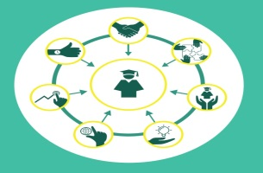


مدرسة موبيكا الدولية للتكنولوجيا التطبيقية
mobica International Applied Technology School
mobica. Capstone Project (2024)
Generated Ideas
Positive outcome if Suggested Solutions applied:
Effort saving، Increase sales، Economic growth، Reducing the percentage of losses، A risk that is guaranteed to be returned with a gain

Slide 9
مدرسة موبيكا الدولية للتكنولوجيا التطبيقية
mobica International Applied Technology School
mobica. Capstone Project (2024)
Generated Ideas
Negative outcome if Suggested Solutions not-applied:
Not selling some clothes due to their incompatibility with modern fashion, and this will lead to any defect in the sale and result in any loss.

Slide 10

مدرسة موبيكا الدولية للتكنولوجيا التطبيقية
mobica International Applied Technology School

